Slide 1
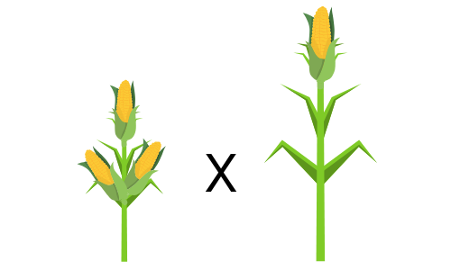
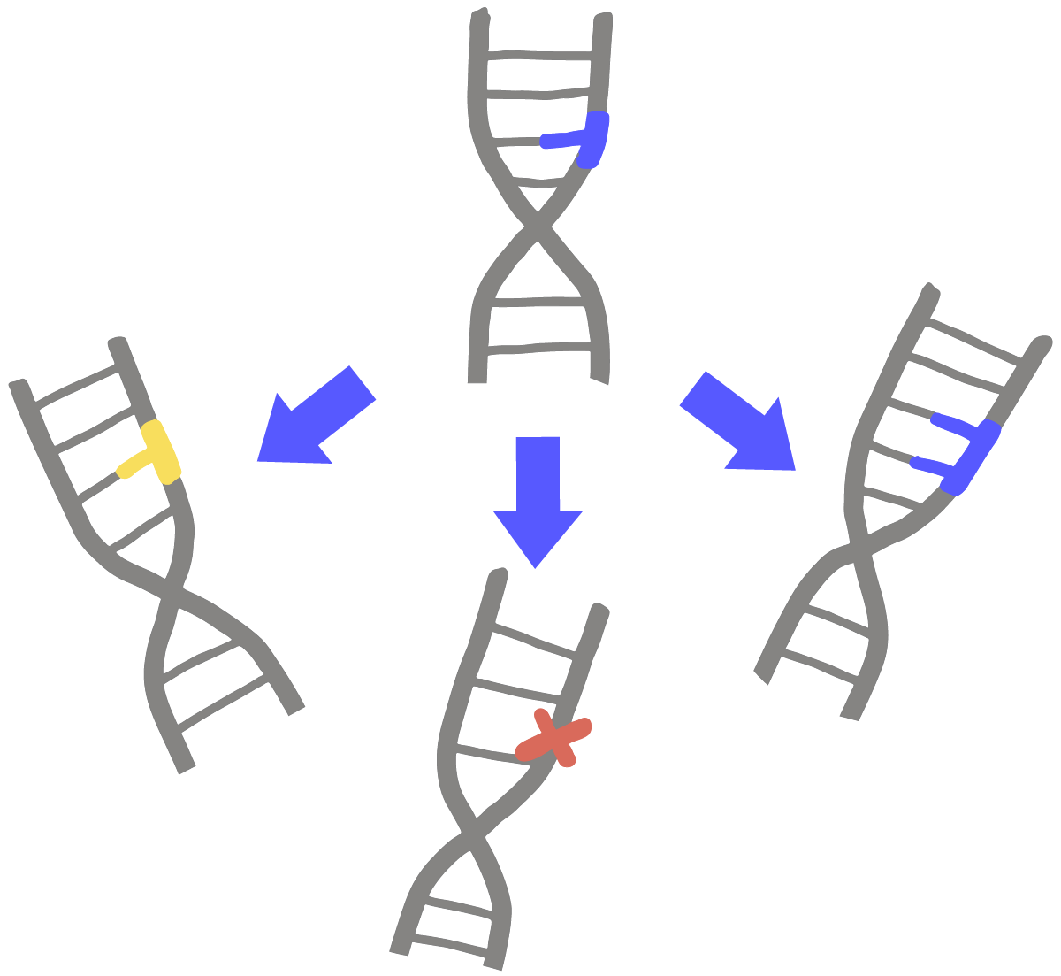
Four Revolutions of Plant Breeding
Selective Breeding | Mutation Breeding | Transgenic Breeding | Genome Editing
Thousands of years | Since 1920s | Since 1980s | Since 2000s
Desired gene is incorporated along with many other genes, which then have to be bred out | Desired mutation is incorporated along with many other random mutations, which may need to be bred out | Only the desired gene is incorporated, but randomly inserted | Wider range of genetic changes achievable, potentially in all crop species
Random, slow, crossing only works within species | Random, unpredictable, but relatively fast | Random insertion, inserts foreign genes | Precise, fast, leaves no trace

