Slide 1















IGI Template Guide & Design Elements
Fonts
Titles: Helvetica Neue Bold
Body text: Helvetica Neue
Title Color: Black or White.
Subtitle Color: IGI Blurple (#5857FF)
IGI Logos
Colors
#5857FF
#898DF9
#BCBEFB
#EEEEFE
#292D39
#696C73
#696C73
#E9EAEB
#EC5121
#96C04B
#FFAC0F
#7ACBC8

Slide 3








Slide 4



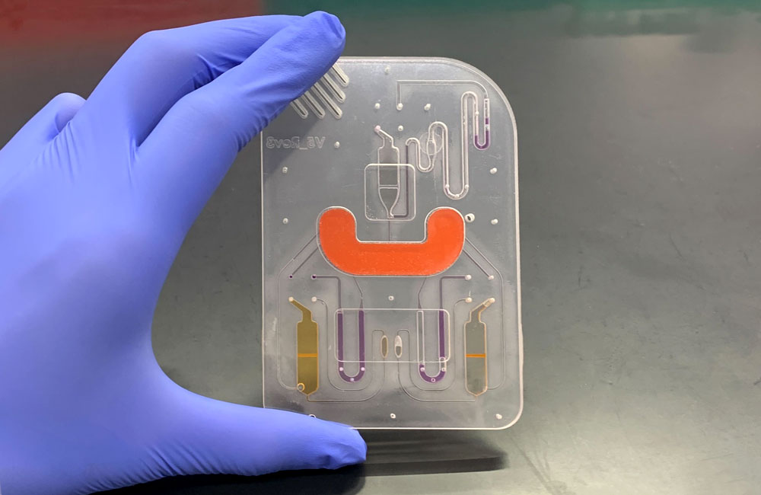

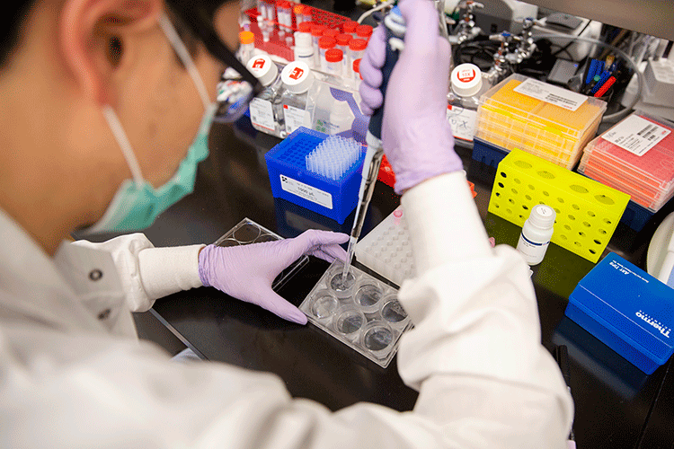


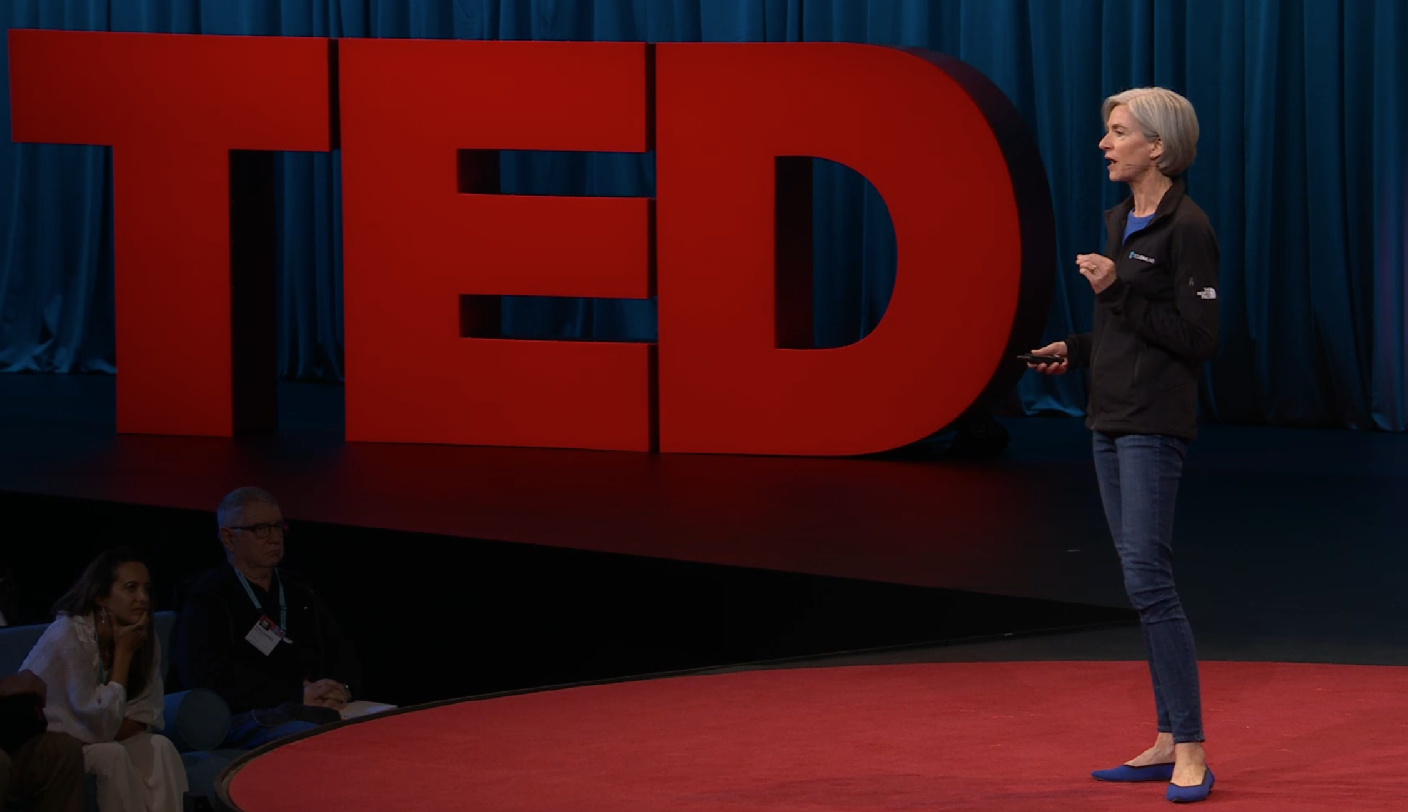
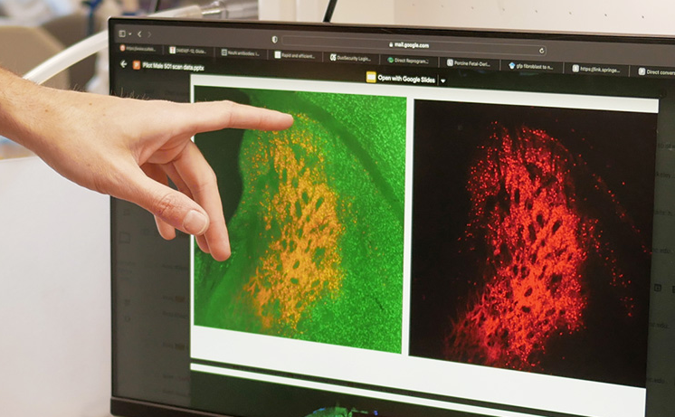
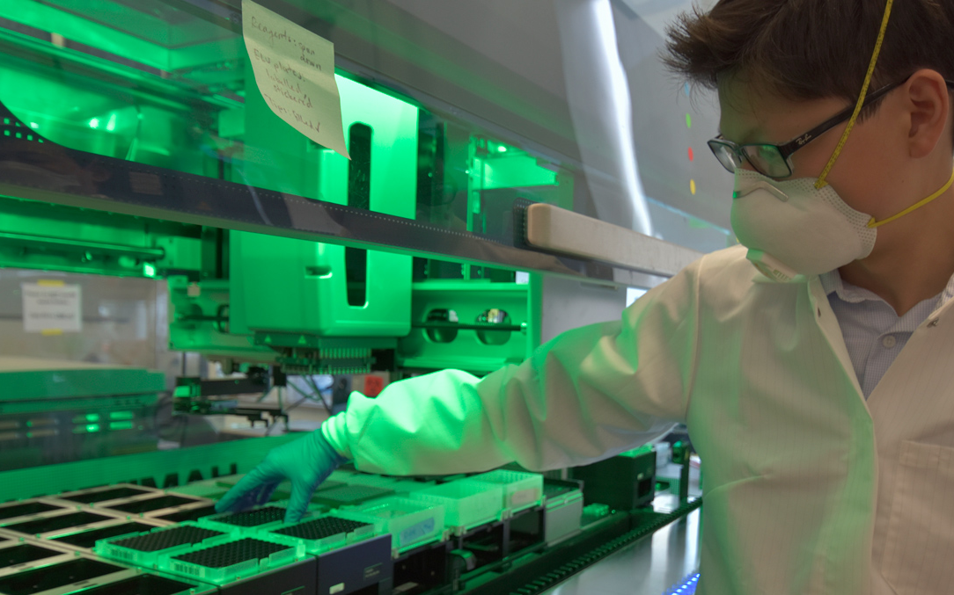
Cutting-Edge Team Science with Social Purpose
The IGI’s mission is to develop revolutionary genome-editing tools and apply them to affordable and accessible solutions in human health, climate, and agriculture.

Slide 5

Catalyzing Innovation & Impact
Founded in 2014 by Jennifer Doudna, recipient of the Nobel Prize in Chemistry for the development of CRISPR genome editing, the IGI is centered on a core insight:
CRISPR is a technology that can apply to all living systems. An innovation in one area of life can apply to all others.
Fostering collaboration between experts in clinical research, plant biology, biochemistry, microbiology, and more leads to cross-cutting innovations in:
New and improved genome editing technology
Genomic screening & target identification
CRISPR delivery technology
Microbiome applications in animals, plants, and soils
Notes:
Founded in 2014 by Nobel Laureate Jennifer Doudna, co-discoverer of CRISPR genome editing, as a non-profit institute in partnership with UC Berkeley and UCSF.
The IGI’s mission is to bridge revolutionary genome-editing tool development to affordable and accessible solutions in human health, climate, and agriculture.

Slide 6
IGI Strategy Overview
Climate & Sustainable Agriculture
Engineer scalable green-tech solutions using plants and microbes
Field Trials
with UC Davis, CGIAR
Genomic Technology Development
Continue IGI’s historic innovation & discovery
Human Health
Make CRISPR the accessible standard of care for all genetic diseases
Clinical Trials
with UCSF, UCLA
Public Impact
Accessible, equitable, community-guided solutions
IGI Innovation
Trials with Partner Support
Basic Research
Applied Research
Translation

